Slide 1
통신공사 구축경로

Slide 2
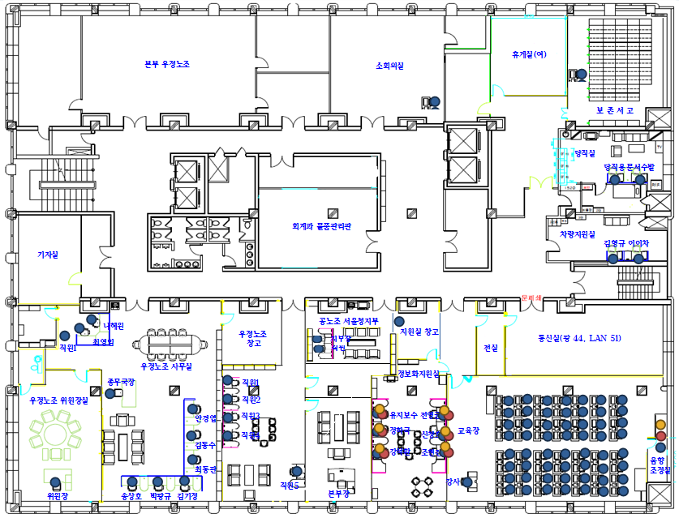
(화상회의실)
1 port
1 port
3 port
2 port
5 port
9 port
6 port
3 port
61 port
21 port

Slide 3
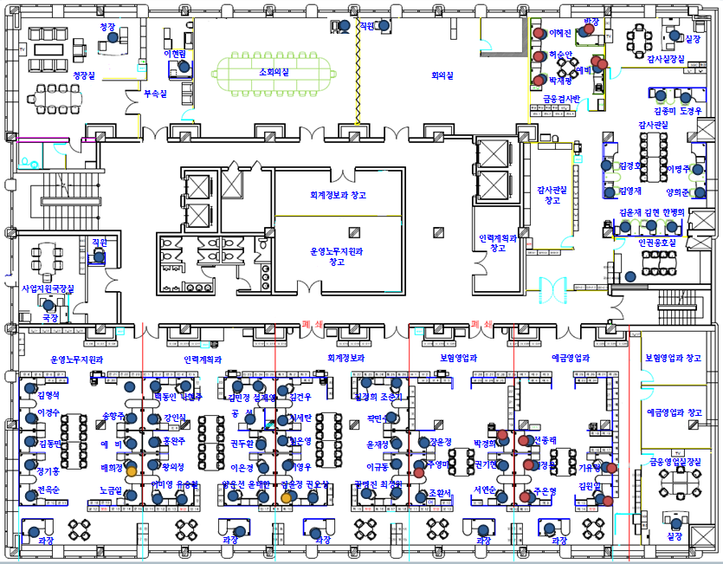
14 port
`
1 port
5 port
1 port
1 port
11 port
1 port
2 port
8F HUB RACK
16 port
19 port
14 port
16 port
19 port
1 port

Slide 4
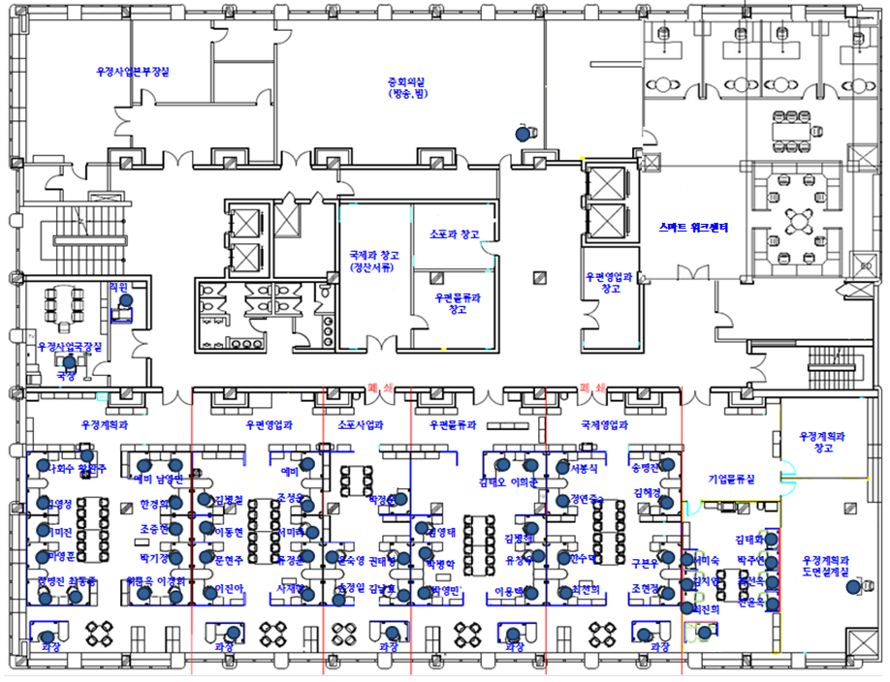
우본LAN
3 port
1 port
15 port
HUB
2 port
9F HUB RACK
12 port
14 port
1 port
19 port
13 port
8 port
10 port
박정운

